Slide 1

Using Chatgpt4o for Diagnosis of Parkinson's Disease
Yankai Zhao
3/22 2025

Slide 2

Catalogue
Purpose
Dataset Preparation
The UPDRS score corresponds to the average duration
Medication analysis
DBS analysis
Patients with and without medication
Patients with and without DBS
Patients with different disease severity
Summary

Slide 3
Purpose:
To test whether AI can understand Parkinson’s patient data and estimate disease severity and the effect of medication and surgerybased on natural language descriptions and Unified Parkinson's Disease Rating Scale (UPDRS)
Figure 1: STS task diagram
Notes:
AccelerometerMeasuring acceleration
Gyroscope
We used CountVectorizer to transform short clinical descriptions (e.g. "slow", "uses arms") into numerical features. This approach is transparent, efficient, and effective for small datasets, and aligns well with the goal of interpretable medical AI.

Slide 4
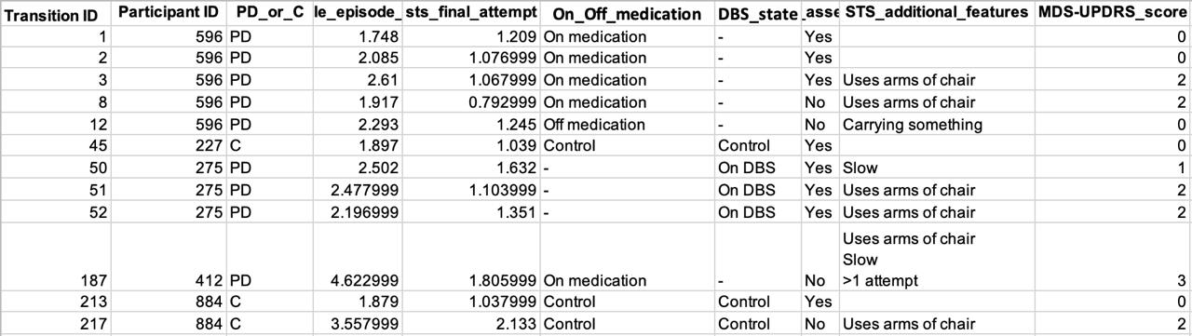
Data Preparation:
Sit-to-Stand (STS) task
Dataset subdivision:
Whole Episode Duration (seconds)
Final Attempt Duration (seconds)
Assistance used (e.g., uses arms of chair)
Movement quality (e.g., slow)
Medication Status (On/Off)
DBS Status (On/Off)
Participant Type (PD / Control)
Patients with and without medication.
Patients with and without DBS treatment.
Patients with different disease severity.
Figure 2: Original dataset

Slide 5
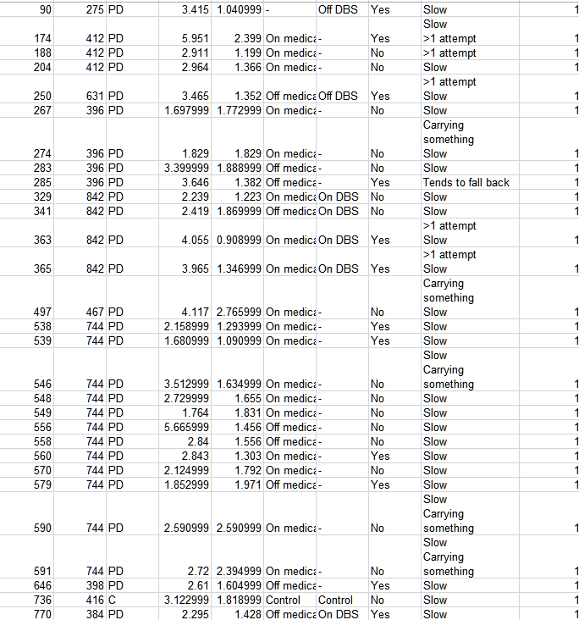
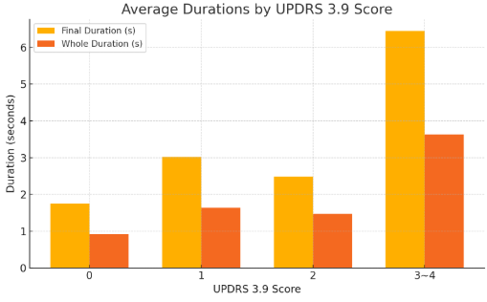
The UPDRS score corresponds to the average duration
Figure 3: UPDRS score and their average duration
Figure 4: UPDRS score 1 data
Although higher UPDRS scores are generally associated with longer standing durations, many patients labeled as score 1 are also marked as "slow." As a result, some of these mild cases actually take longer to stand than certain score 2 patients.
Notes:
0 = 1.748, 0.9182
1 = 3.025, 1.6393
2 = 2.4816, 1.47224
3,4 = 6.4475, 3.63299
Mufd Yf, [2025-03-26 20:18]

Slide 6
Medication analysis:
Patient 842:
Trail 329-337: On medication
-average durations: 2.119, 0.962
- score: 1.444
Trail 341-360: Off medication
-average durations: 5.223, 3.133
- score: 2.09
Trail 329-337: On medication
-average durations: 2.516, 1.085
- score: 1.375
Patient 412:
Trail 174-192: On medication
-average durations: 2.768, 1.664
- score: 1.75
Trail 198-203: Off medication
-average durations: 5.223, 3.133
- score: 2
Trail 204-206: On medication
-average durations: 1.793, 1.018
- score: 1.666
Patients on medication tend to have lower UPDRS scores and shorter standing durations, indicating better motor performance.

Slide 7
DBS analysis:
Patient 275:
Trail 50-81: On DBS
-average durations: 2.425, 1.419
- score: 1.45
Trail 86-91: Off DBS
-average durations: 3.461, 1.543
- score: 1.2
Patient 384:
Trail 754-759: On DBS
-average durations: 2.338, 1.489
- score: 2
Trail 762-774: Off DBS
-average durations: 2.429, 1.534
- score: 1.666
Trail 777-780: On DBS
-average durations: 2.485, 1.380
- score: 1.875
Patients off DBS often receive lower scores despite having longer standing durations, possibly due to suppressed or less obvious compensatory behaviors.

Slide 8
Patients with and without medication

Slide 9
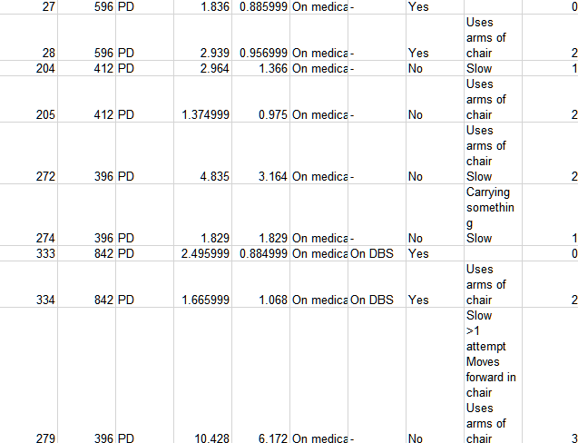
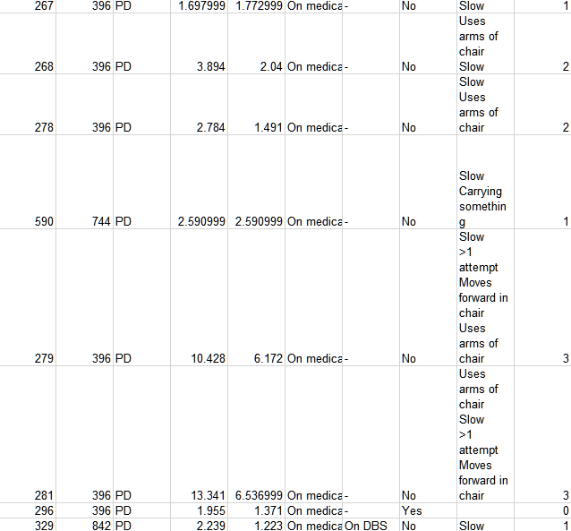
Patients with and without medication
On-medication:
A. Training data
B. Testing data
9
Notes:
Hi. Now you are a neurologist specializing in assessing the motor abilities of patients with Parkinson’s Disease, particularly their ability to arise from a chair (Arising from Chair). You will receive a dataset of patients who are on medication, including their official UPDRS 3.9 scores given by doctors. Your task is to analyze this data and learn which factors influence the UPDRS 3.9 score (ranging from 0 to 4). Then, I will provide you with new patient data, also from medicated patients, but without the UPDRS 3.9 score. Using your medical expertise (derived from the learned data patterns), you need to predict their UPDRS 3.9 scores.

Slide 10
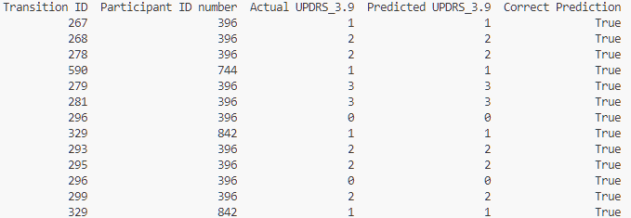
Patients with and without medication
On-medication:
Figure 5: On-medication prediction
The overall prediction accuracy was 100% (13 out of 13 correct predictions)
10

Slide 11
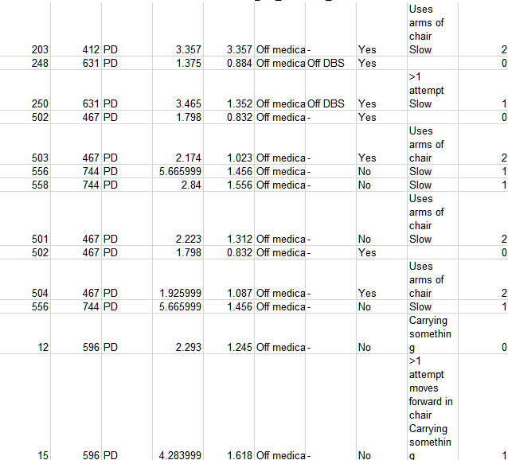
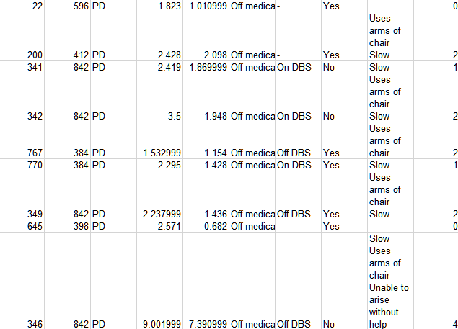
Patients with and without medication
Off-medication:
A. Training data
B. Testing data
11

Slide 12
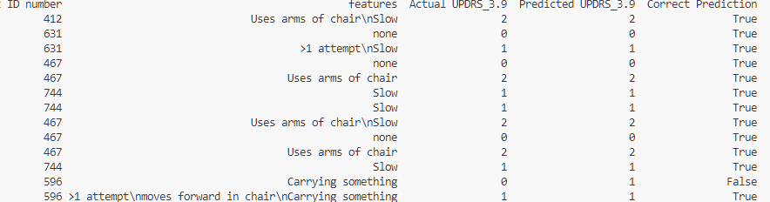
Patients with and without medication
Off-medication:
Figure 6: Off-medication prediction
The overall prediction accuracy was 92.31% (12 out of 13 correct predictions)
12

Slide 13
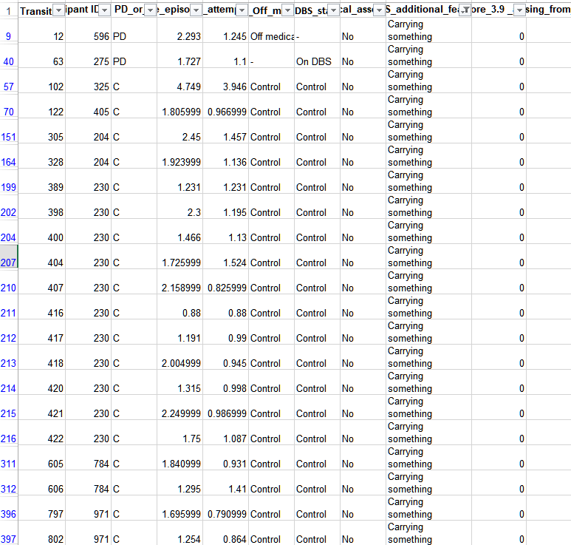
Patients with and without medication
False cases:
Model prediction:
In the data set that all experiments with a “carrying something” tag have a score of 0. But this label is not covered in the training set.
Figure: Carrying something all have a score of “0”
Notes:
0 = 1.748, 0.9182
1 = 3.025, 1.6393
2 = 2.4816, 1.47224
3,4 = 6.4475, 3.63299
Mufd Yf, [2025-03-26 20:18]
In Off medication dataset only have this one with “carrying something”

Slide 14
Patients with or without DBS treatment

Slide 15
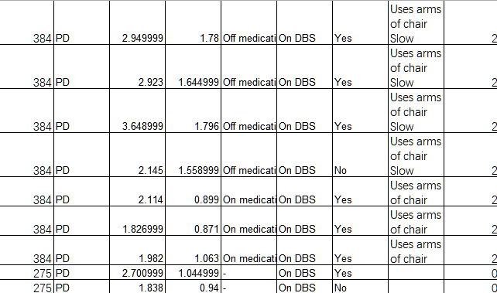
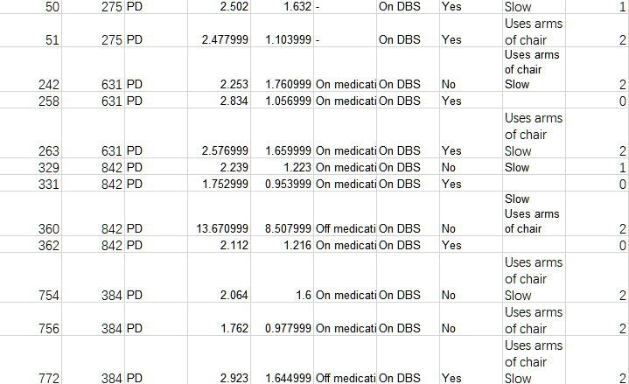
Patients with or without DBS treatment.
On-DBS:
A. Training data
B. Testing data
15

Slide 16
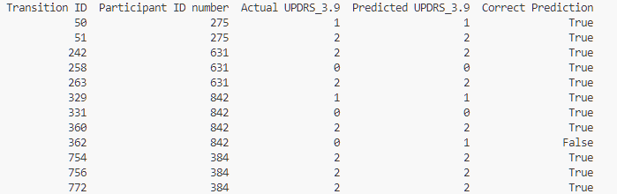
Patients with or without DBS treatment.
On-DBS:
Figure 7: On-DBS prediction
The overall prediction accuracy was 91.67% (11 out of 12 correct predictions)
16

Slide 17
Patients with or without DBS treatment.
False cases:
Model prediction:
Score “0” duration < Trial “362”Duration = 1.216 < Score “1” duration
Notes:
0 = 1.748, 0.9182
1 = 3.025, 1.6393
2 = 2.4816, 1.47224
3,4 = 6.4475, 3.63299
Mufd Yf, [2025-03-26 20:18]

Slide 18
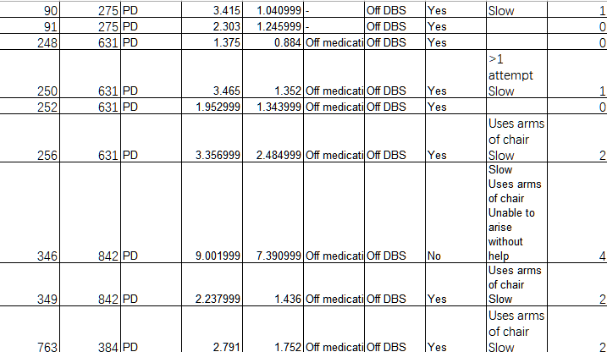
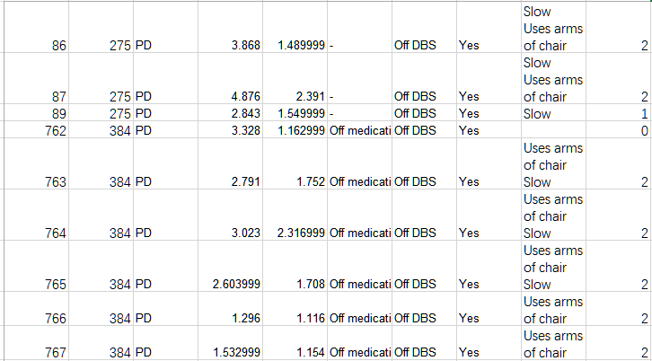
Patients with or without DBS treatment.
Off DBS:
A. Training data
B. Testing data
18

Slide 19
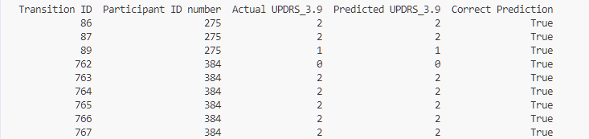
Patients with or without DBS treatment.
Off-DBS:
Figure 8: Off-DBS prediction
The overall prediction accuracy was 100% (9 out of 9 correct predictions)
19

Slide 20
Patients with different disease severity

Slide 21
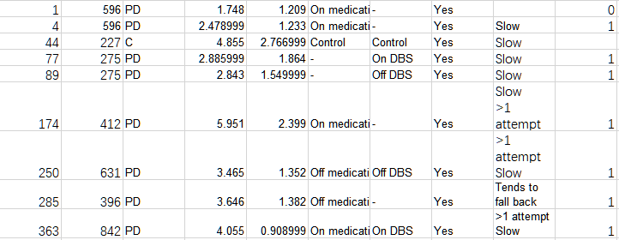
Patients with different disease severity
Mild Training Data: (UPDRS: 0-1)
21

Slide 22
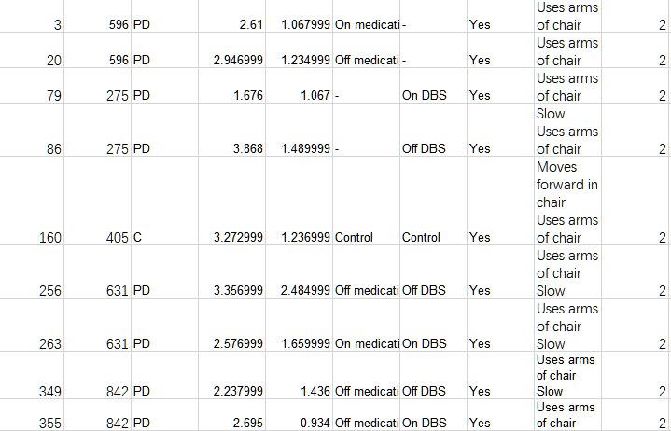
Patients with different disease severity
Moderate Training Data : (UPDRS: 2)
22

Slide 23
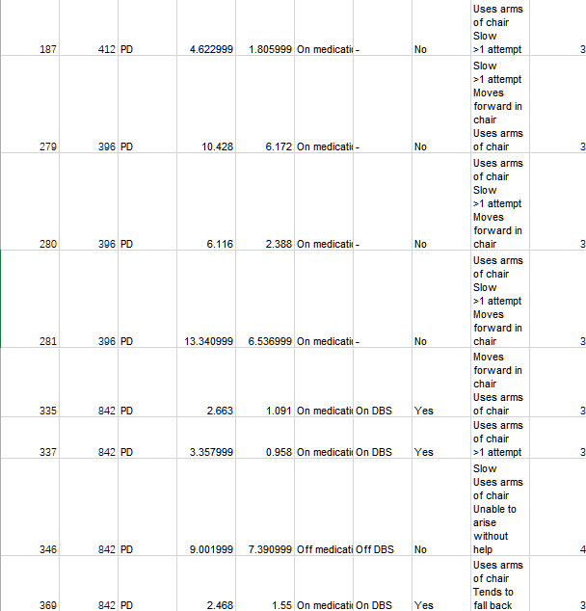
Patients with different disease severity
Severe Training Data : (UPDRS: 3-4)
23

Slide 24
Patients with different disease severity
Misclassified Cases:
Figure 8: combination prediction
The overall prediction accuracy was 92.98％ (53 out of 57 correct predictions), All false data with a true score of 0
24

Slide 25
Summarize:
GPT shows potential in estimating UPDRS scores, but accuracy varies based on medication status, DBS treatment, and disease severity.
On-medication(100%) patients are now predicted with high accuracy. Their motor symptoms are typically more stabilized or controlled, and their clinical descriptions (e.g., "uses arms", "slow") are clearer and easier for the model to interpret. Off-medication(92.31%) patients show more variability, which sometimes leads to ambiguous expressions of mild symptoms and thus slightly lower prediction accuracy.
Off-DBS(100%) patients often exhibit more severe or unmasked symptoms, making classification easier. On the other hand, On-DBS(91.76%) patients tend to show improved but still variable behaviors—such as faster movement with mild assistance—which fall into a gray zone and are more difficult to classify consistently.
Most of misclassified samples in this evaluation were patients with a true UPDRS score of 0. These mild cases often had slightly longer stood durations or vague feature labels such as "carrying something" or "none". Because their motor behavior overlaps with both normal and early-stage PD patterns, the model occasionally predicts a score of 1 instead of 0. This confirms that the boundary between normal and mildly impaired is the most challenging area for automated scoring.

Slide 26
Thank you

Slide 27
2. Patients with or without DBS treatment.
Causal hypothesis:
DBS ON:
Providing more stable motor performance and therefore clearer symptom patterns, facilitating better model predictions.
DBS OFF:
Might experience more unpredictable and variable symptoms, reducing model performance.
DBS therapy can effectively stabilize and clarify the movement patterns of patients, thus greatly improving the predictive performance of machine learning models.
27

Slide 28
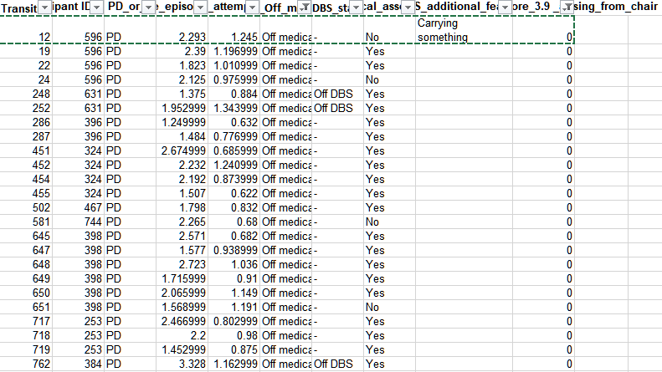

Slide 29
3. Patients with different disease severity
Outcome analysis:
Mild cases (UPDRS 0-1) still have the lowest accuracy (59.1%)
The model continues to struggle with early-stage Parkinson’s cases, likely because mild symptoms vary more and overlap with normal movement patterns. Some mild cases are still misclassified as moderate or severe.
Moderate cases (UPDRS 2) improved slightly (74.1%)
The model is handling UPDRS 2 cases more consistently but still occasionally misclassifies them as mild or severe.
Severe cases (UPDRS 3-4) remain perfectly classified (100%)
This suggests that patients with severe Parkinson’s have very distinct movement patterns, making it easier for the model to classify them correctly.
29

